Slide 1
Social Media
Planner Comparisons

Slide 2
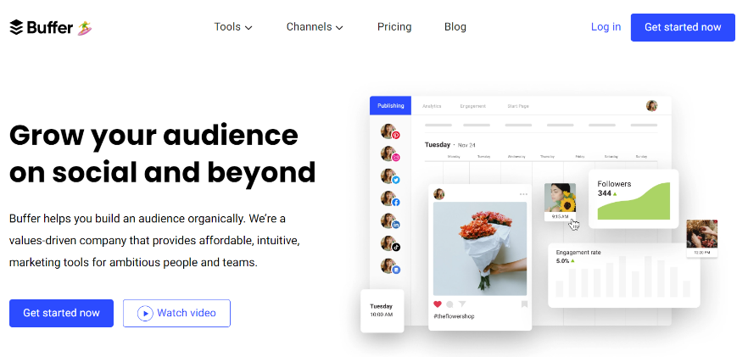
FREE PLAN INCLUDES:
1 User
3 Profiles
Supports Facebook, LinkedIn, Instagram, Twitter, Pinterest, and more
PAID PLAN OPTIONS AT $6, $12, OR $120 PER MONTH
NOTEWORTHY FREE FEATURES
Posting Schedules: Set content in your queue to automatically publish on the day and at the time you choose.
Shuffle Queue: Shuffle posts on similar content to publish in a random order to add variety to your feeds.
Google Analytics Tracking: See how much traffic your social media posts are driving and adjust your strategy accordingly.
Start Pages: Create short landing pages to tell people about your business, direct them to content outside of social media or provide specific information.
Notes:
https://buffer.com/

Slide 3
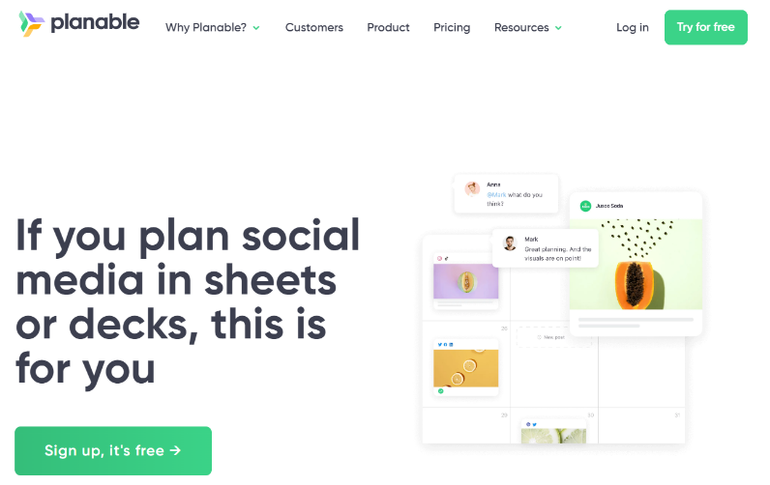
FREE PLAN INCLUDES:
1 User
Unlimited Profiles
Supports Facebook, LinkedIn, Instagram, Twitter, Pinterest, and more
PAID PLAN OPTIONS AT $11, $22+
PER MONTH
NOTEWORTHY FREE FEATURES
Visual Platform: Create, plan, collaborate, review, and schedule social media content.
Image editing: Edit images in the same place you manage your social.
Notifications: Get notifications when posts are reviewed, approved, or published.
Notes:
https://planable.io/

Slide 4
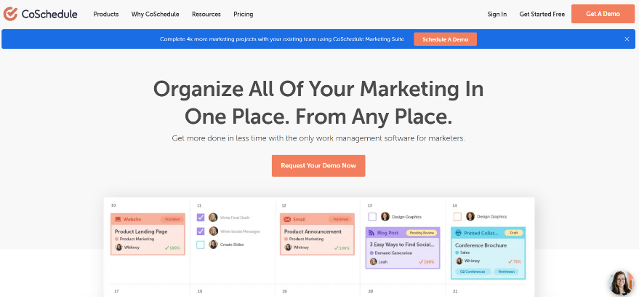
FREE PLAN INCLUDES:
1 User
2 Profiles
Supports Facebook, LinkedIn, Instagram, Twitter, Pinterest, and more
PAID PLAN OPTIONS AT $29+ PER MONTH
NOTEWORTHY FREE FEATURES
Messages and Campaigns: Schedule a single post or a series of messages to post across multiple networks over time.
Best Time Scheduling: Guidance on when posts are most likely to get good visibility and engagement. Evergreen content can be automatically reshared according to your publishing schedule.
Historical Social Message Imports: When you create a new social profile, CoSchedule imports the last 60 days of posts or up to 100 past posts so you can measure or reschedule them.
Notes:
https://coschedule.com/

Slide 5
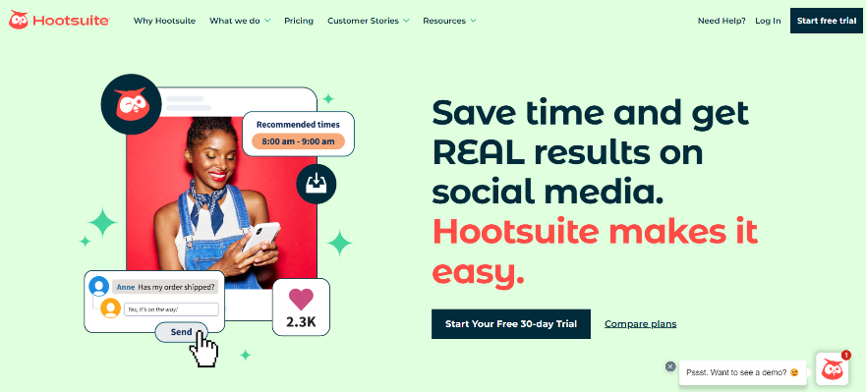
FREE PLAN INCLUDES:
1 User
2 Profiles
Supports Facebook, LinkedIn, Instagram, Twitter, Pinterest, and more
PAID PLAN OPTIONS AT $99, $249+
PER MONTH
NOTEWORTHY FREE FEATURES
Content customization: Schedule posts across your social networks simultaneously but tweak the post for each platform.
Streams and boards: Set up boards to monitor activity on your social media accounts for each feed or discover new content, conversations, and trends.
Promoted posts: Reach more of your target audience on Facebook, LinkedIn and Instagram with the Boost Feature.
Notes:
https://www.hootsuite.com/

